Slide 1
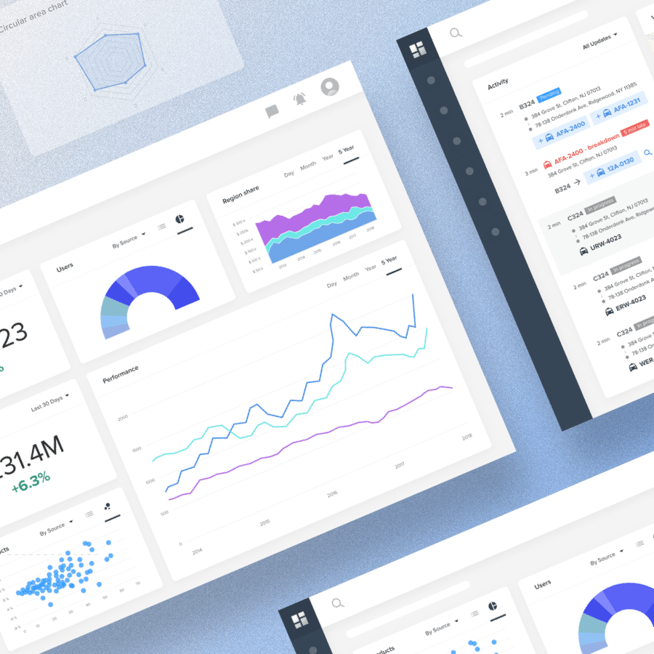
Indian Liver Patient Dashboard
Group Project – ST3011
Department of Statistics
Group A
S13825 – Chamath De Silva
S13871 – Moditha Subasinghe
S14041 – Udani Chethana
S14058 – Eranga Harshani
S14089 – Hashan Maduraarachchi
S14108 – Dinushi Ranasinghe
S14119 – Shahan Gamage

Slide 2
Introduction
A data dashboard is a visual display of the most important information needed to achieve one or more objectives, with the data consolidated and arranged on a single screen so the information can be monitored at a glance.
This dashboard enables healthcare professionals to access important patient statistics to increase the overall hospital performance and patient satisfaction.
Indian liver patient's dataset has used to create the dashboard. To compare response variable with the explanatory variables, here used bar graphs, pie charts and multiple bar graphs.

Slide 3
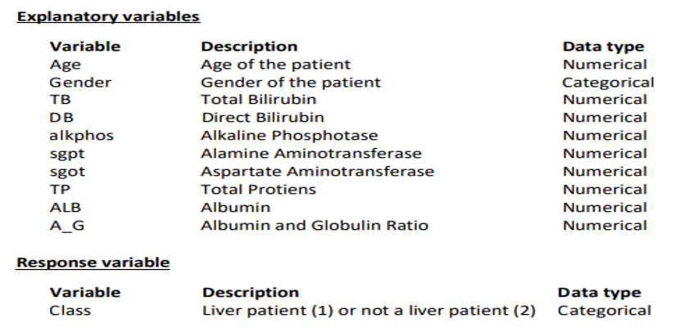
Dataset
Indian Liver Patient Data Set (ILPD) consists of 583 observations under 10 explanatory variables and one response variable.

Slide 4
Objectives
To determine the distribution of liver patients with gender.
To determine the age distribution of the liver patients (below 18 years, 19-50 years, over 50 years).
To find-out overall count of liver patients and non-liver patients.
To access the liver patients along with the gender with respect to their age range
To graphically represent whether a liver patient or not and the total count, along with the ranges in results of liver abnormality tests.

Slide 5

Methodology & Framework
Anaconda
Anaconda Navigator is a desktop graphical user interface (GUI) included in Anaconda distribution that allows you to launch applications and easily manage conda packages, environments, and channels without using command-line commands.
Jupyter Notebook
Open-source web application that allows you to create and share documents that contain live code, equations, visualizations, and narrative text.
Dash
Open-source Python framework used for building analytical web applications

Slide 6
Methodology & Framework
Dash Core components
Include a set of higher-level components like dropdowns, graphs, markdown, blocks and many more.
Dash HTML Components
A library contains a component class for every HTML tag as well as keyword arguments for all the HTML arguments
Pandas Framework
A library written for the Python programming language for data manipulation and analysis

Slide 7
Methodology & Framework
NumPy
A Library that provides a simple yet powerful data structure which is mostly a Python library used when working with arrays.
Plotly & Plotly Express
Interactive, open-source, and browser-based graphing library
Plotly Express is a new high-level Python visualization library which is a wrapper for Plotly.py.
Dash Dependencies
Used in order to make the Dash app interactive by importing input and output from dash.dependencies.

Slide 8
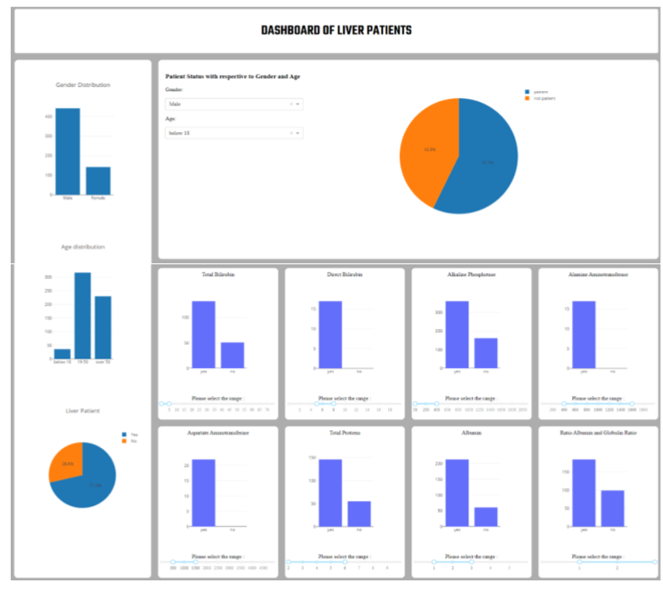
USAGE OF THE DASHBOARD
OVERALL INTERFACE
Two subtopics
General analysis
Advanced analysis

Slide 9
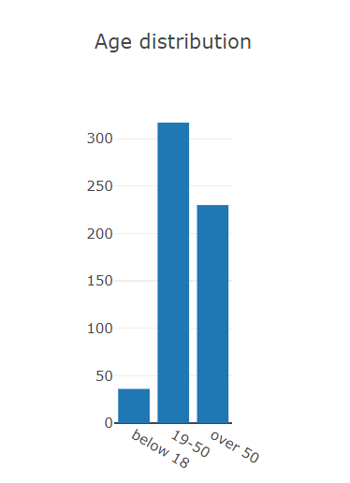
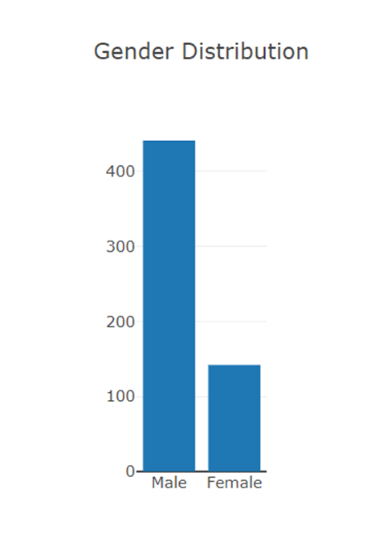
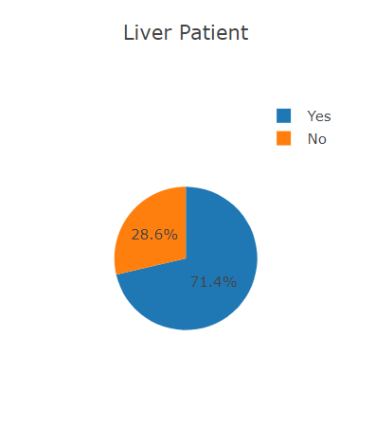
General Analysis

Slide 10
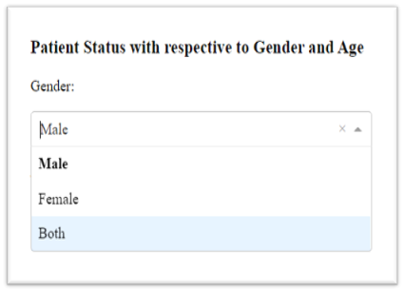
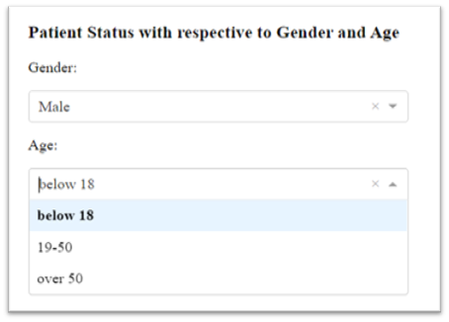
Advanced Analysis
Patient status with respect to Gender and Age
This is a demonstration of patient status with respect to Gender and Age using pie charts.
Two drop down boxes are used here

Slide 11
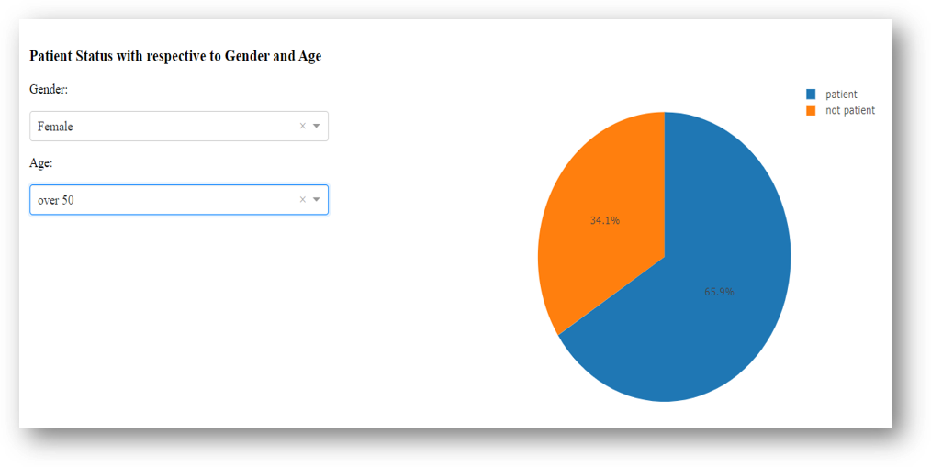
Advanced Analysis

Slide 12
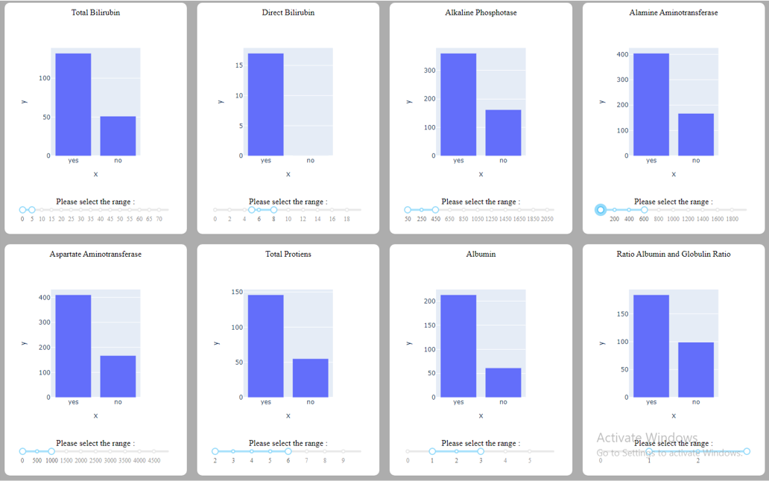
Advanced Analysis
Further analysis on each explanatory variable is graphically represented by bar graphs in the dashboard.

Slide 13


